Slide 1
The Battle of Neighborhoods
IBM Data Science Capstone Project

Slide 2
Introduction
New York's demographics show that it is a large and ethnically diverse metropolis. It is the largest city in the United States with a long history of international immigration. New York City was home to nearly 8.5 million people in 2014, accounting for over 40% of the population of New York State and a slightly lower percentage of the New York metropolitan area, home to approximately 23.6 million. Over the last decade the city has been growing faster than the region. The New York region continues to be by far the leading metropolitan gateway for legal immigrants admitted into the United States.
Throughout its history, New York City has been a major point of entry for immigrants; the term "melting pot" was coined to describe densely populated immigrant neighborhoods on the Lower East Side. As many as 800 languages are spoken in New York, making it the most linguistically diverse city in the world. English remains the most widely spoken language, although there are areas in the outer boroughs in which up to 25% of people speak English as an alternate language, and/or have limited or no English language fluency. English is least spoken in neighborhoods such as Flushing, Sunset Park, and Corona.
With the diversity in their culture , New York have diverse cuisines. There are many resturants in New york City belonging to different cuisines like Chinese , Vietnamese , French etc.

Slide 3
Data
For this project we need the following data :
New York City data that contains list Boroughs, Neighborhoods along with their latitude and longitude.
Data source : https://cocl.us/new_york_dataset
Description : This data set contains the required information. The data is used to explore various neighborhoods of NYC.
Vietnamese restaurants in each neighborhood in NYC.
Data source : Fousquare API
Description : All the venues is archieved in each neighborhood by using the API. Venues are selected to obtain only Vietnamese resturants info.

Slide 4
Approach
Collect the NYC data from https://cocl.us/new_york_dataset
Using FourSquare API we will find all venues for each neighborhood.
Filter out all venues which are Vietnamese Resturants.
Find rating , tips and likes for each Vietnamese Resturants using FourSquare API.
Using rating for each resturant , we will sort that data.
Visualize the Ranking of neighborhoods using folium library(python)

Slide 5
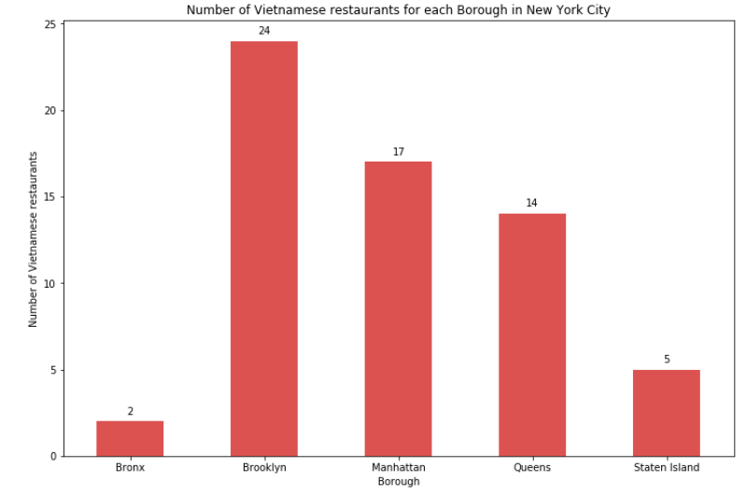
Analysis

Slide 6
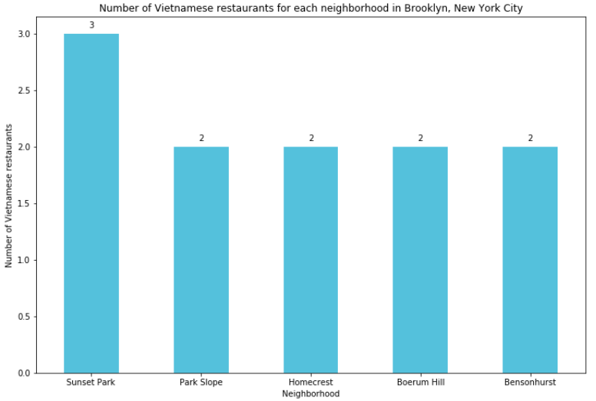
Analysis

Slide 7
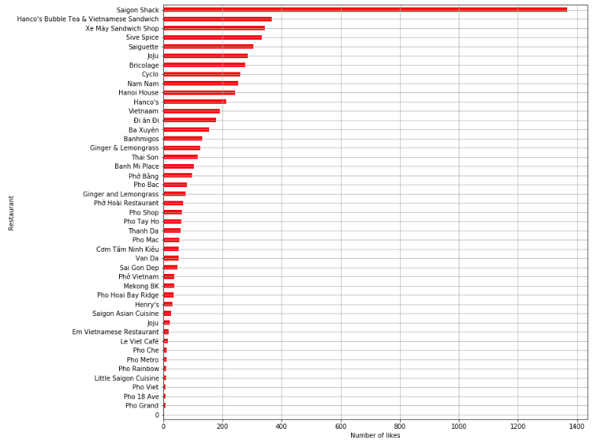
Analysis

Slide 8
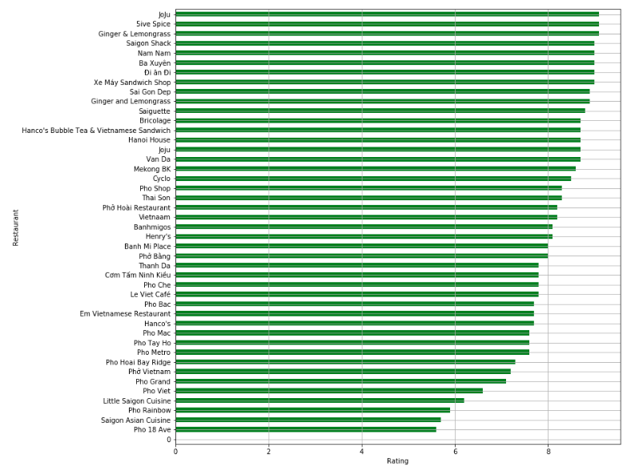
Analysis

Slide 9
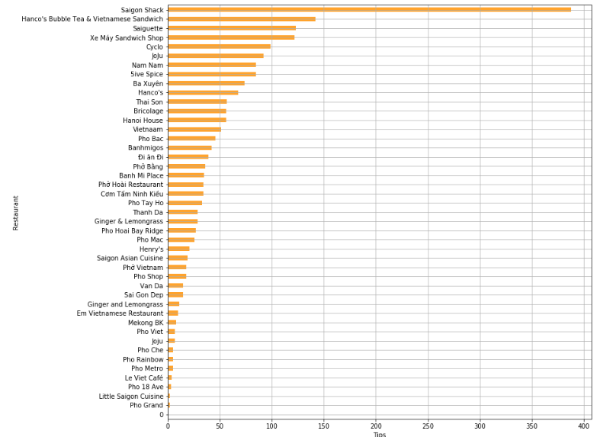
Analysis

Slide 10
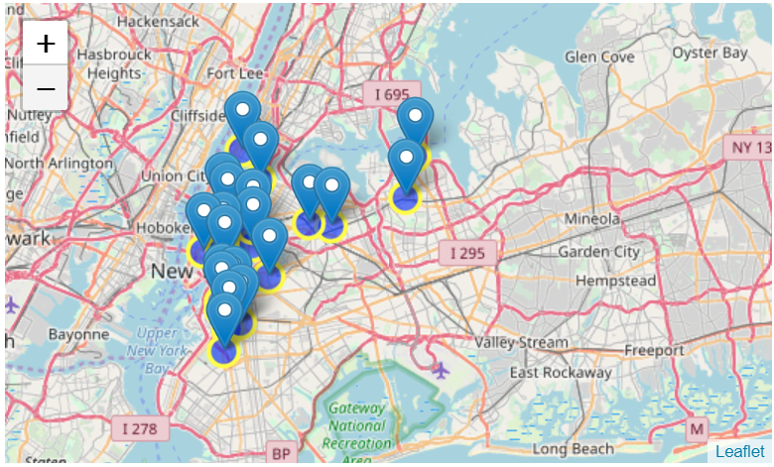
Analysis

Slide 11
Conclusion
Noho (Manhattan), Greenpoint (Brooklyn), Greenwich Village (Manhattan) are some of the best neighborhoods for Vietnamese cuisine.
Brooklyn have good potential Vietnamese restaurants.
Manhattan is the best place to stay if you prefer Vietnamese Cuisine.
5iveSpice ranks first in rating of Vietnamese Restaurants in NYC.

